Slide 1
MoneyCounts: A Financial Literacy Series
Debt Management
11-A Grange Building
University Park, PA 16802
financialliteracy.psu.edu
finlit@psu.edu
814-863-0214

Slide 2
Description
Many people face a financial crisis at some point in time. It can be overwhelming, but it also can be overcome!
Debt management helps you build a realistic budget and make a financial plan to free yourself from being shackled with debts!

Slide 3
Learning Outcome
Recognize the symptoms of uncontrollable debt
Make a plan to combat and manage your financial crisis
Explore options in debt management
Learn how to avoid scams

Slide 4
How much debt is too much?
DEBT

Slide 5
U.S. Census Bureau (Statistics)
69 % of Americans are in debt by an average of $70,000.
Consumers with the greatest amount of growing debt were those in the age group of 35 to 45, with roughly $108,000 in debt.
People aged 45 to 55 were carrying $86,500 in debt.
People aged 55 to 65 were saddled with $70,000 in debt.
College students graduate with an average of $37,000 in student loans.
Penn State Adult students graduate with an average of $40,000 in student loans.

Slide 6
Penn State Student Aid Office (Statistics)
66% of students who graduate each semester are carrying student loan debts.
Average student loan debt: $35,639 (2012-2013)
Adult students graduate: $40,000 (2012-2013)
Repayment of student loan debt ranges between 10-30 years depending on payment plan
Average monthly payment on a standard 10 year plan is $400 - $700

Slide 7
Symptoms of overspending
Having no significant savings
Paying debt more than 10% of net income
Paying the minimum amount on your credit card bill
Paying late fees on bills
Utilities are threatened to be disconnected
Receiving collection dunning letters or phone calls
Not getting ahead even with multiple jobs
Being worried you might lose your home or car
Having no financial goals in your life
Stop! If

Slide 8
Danger of overspending
Overspending can lead to excessive debt
Overspending makes it difficult to set and reach financial goals
Overspending prevents building financial wealth
College fund
Retirement
Vacation
Overspending can ruin your financial reputation
Overspending can push you into bankruptcy

Slide 9
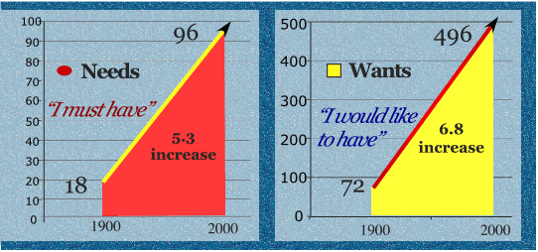
Back to basics!
Needs
Wants
Notes:
“At the beginning of this century, the average American had 72 wants and considered 18 of them important. By the end of the century, the average American had 496 wants and considered 96 of them as genuine necessities for happiness.” (Miller)

Slide 10
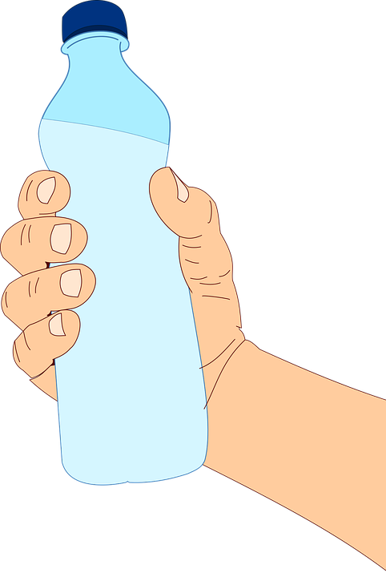
Every penny counts!
Buying one bottle of water a day $1.50
 | # of Days | Amount
Cost of one bottle of water |  | 1.50
Cost per week | 7 | 10.50
Cost per year | 365 | 547.50
Cost in 10 years | 3650 | 5,475.00
Cost in 20 years | 7300 | 10,950.00
Cost in 30 years | 10950 | 16,425.00 | Net
Pre-tax needed (30%Tax) |  | 23,464.00 | Gross

Slide 11
Re-do your budget!
Recommended budgeting as a percentage of net income

Slide 12
Where to start?
Identify personal debt
Identify outstanding debt
Review budget and minimum monthly payment
Eliminate/reduce High interest loans
Negotiate credit cards interest rates
Freeze some cards

Slide 13
Know your rules
To keep debt in check, follow the rule of 20/10
To Keep mortgage in check, follow this rule:
Monthly payment, including insurance, tax, and interest should not be more than 30% of your net monthly income
Credit card
Student loan
Car loan
Personal loan
(excluding mortgage)
20% of your yearly net income
Debt
Monthly Payment
10% of your monthly net income

Slide 14
Other options
Depending on your level of debt, there are different options for different situations
Debt Settlement
Debt Repayment Plans
Bankruptcy
Debt Negotiation
Debt Consolidation
*Consider all options before Bankruptcy!

Slide 15
Debt Consolidation
Taking one new debt to cover all debts
New interest rate, terms of payment
Reduce or eliminate all late fees and penalties to debtor
Overall higher cost but easier monthly payments
Fees of service required up front

Slide 16
Debt Negotiation
Negotiating to adjust terms of debts
The concept is to convince creditors to reduce the total amount of money owed in lieu of a set fee.
The set fee is required to be paid up front
Creditors are under no obligation to accept debt negotiation

Slide 17
Debt Repayment Plans
Restructuring for easier monthly payments
Usually higher interest rates
Longer # years
Higher overall cost
Creditors are under no obligation to accept
Fees for service required up front

Slide 18
Debt Settlement
Offering % to settle the debts, a step before full bankruptcy, takes 3-5 years to complete and affects credit 7-10 years
Acceptance of settlement is optional (It could be rejected by creditors)
Fees and interest keep accruing while settlement is in process
Cost of services is an added burden to the debts and is usually required up front

Slide 19
Bankruptcy (Last Resort)
Bankruptcy
Chapter 7: Liquidation – Assets are sold to satisfy debts – Gets rid of unsecured debts such as credit cards - Low income
Chapter 13: Reorganization – Income is used to satisfy debts - Repayment plan – assets are kept – Pays non dischargeable debts such as child support or alimony
Student loans are not dismissible in a bankruptcy!

Slide 20
Avoid scams – Federal Trade Commission
Don’t believe!
They will promise they can reduce your debt to the point that you’re paying pennies on the dollar for what you actually owe.
They will promise that some of your debt will be eliminated entirely.
They lie and tell clients that unsecured creditors do not sue debtors for non-payment.
They claim they can remove negative information from your credit report.

Slide 21
Tough Economic Times
Stop
Stop “ALL” spending you can “LIVE” without
Go back to basics!
Stretch your savings. Do not deplete fast.
Review
Review your existing expenses against your income and adjust accordingly
Recognize
Recognize spending leaks and stop them
Combine trips to the market and save on gas
Find
Find creative ways to increase income and/or control spending
Garage sale
Barter for things that you need
Have pot luck gathering instead of going out to dinners with friends and family

Slide 22
Cut spending painlessly
Target areas with indirect impact on your spending
Car Insurance Premium: Evaluate your risk tolerance
Reduce Spending gradually
Instead of eating out 5 times a week, reduce to 2-3 times
Instead of renting movies, check out free movies from libraries
Instead of ordering latte each morning, make coffee at home
Turn down the heat/cool a bit (but stay comfortable and healthy)
Watch groceries spoilage and waste
Use items before expiration date. Buy what you and your family eat
Clean and organize closets and garage (Garage Sale!)
Open a saving account with proceed

Slide 23
MoneyCounts: A Financial Literacy Series
Comments and questions
11A Grange Building
University Park, PA 16802
financialliteracy.psu.edu
finlit@psu.edu
814-863-0214

